Slide 1
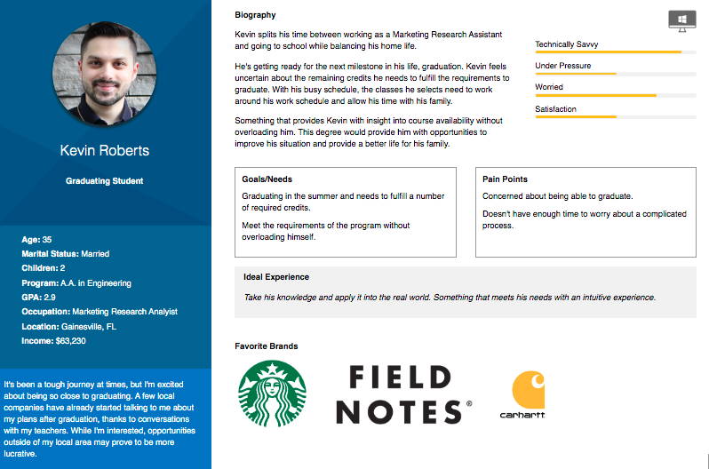

Slide 2
Kevin Roberts User Journey
Persona
Kevin Roberts, 35, Engineering, A.A. Program
Scenario
Kevin is ready to graduate, with his last semester at SFC in sight, he accesses the AP to sort out his remaining requirements.
Academic Planning v1
Access
Planning
Consideration
Submit Term
Support
User Actions | Signs into eSanta Fe Clicks the Academic Planning Link. Lands on the AP Dashboard. | Visually scans the courses. Sees the failed course. Clicks to view details. | Talks about the failed course with an academic advisor. | Clicks the FINISH button for the final term of his 2nd year. | Kevin receives an email 24 to 48 hours later outlining the process with the failed class.
Touchpoints
Emotions
Pain Points | Uncertain about meeting his credit hours in order to graduate. | Needs the required course in order to graduate. | Having to retake the course this close to graduation is frustrating. |  | Wants a paper trail or documentation stating that he is now in good standing for the upcoming term.
Solutions | Provide clear access points to help information and academic advisors, plus an example audit. |  | The advisor in contact with Kevin would need to re-open the course. |  | All users receive a follow up email 24 hours after submission with resources and articles.
eSanta Fe Login
Matrix
Cards
Advisor
Cards
Finish Button
eSanta Fe Menu
Course Details
Matrix
Term
AP button on Dashboard
Term
Hard Error
Next Button

Slide 3
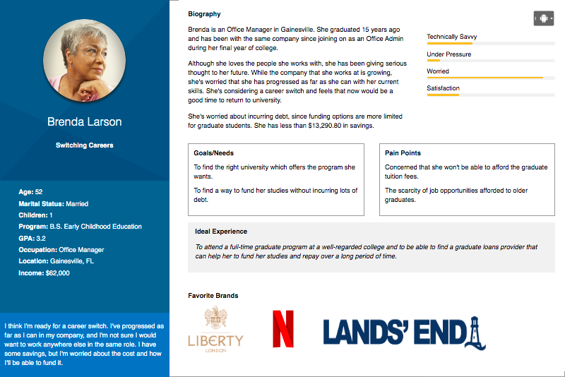

Slide 4
Brenda Larson User Journey
Persona
Brenda Larson, 52, Early Childhood Education, B.S.
Scenario
Brenda is gearing up to go back to school. As a first time student at this college, Brenda needs to begin planning.
Academic Planning v1
Access
Planning
Consideration
Submit Term
Support
User Actions | Signs into eSanta Fe Clicks the Academic Planning Link. Lands on the AP Dashboard. | Scans the initial plan for the active term. Reads intro text and assesses the plan. | Taps on listed course. Makes a course substitution. New course requires a pre-req. Chooses alternative. | With all requirements listed, submits term. Moves onto the next term in the process. | Clicks the FINISH button for the final term of her 3rd year. Opts into email updates.
Touchpoints
Emotions
Pain Points |  | The initial Academic Plan course load can appear daunting to first time users. | Class she wanted to take is not available due to a pre-req. It’s a minor setback, but frustrating. | Brenda is uncertain about her changes and would like to talk with an advisor during the process.
Solutions |  | Provide clear access points to help information and academic advisors, plus an example audit. | Alert the user that pre-reqs are required and present them with alternatives. | Put up clear text areas stating that submitting a term is a final step. Give the option for advisor review. | Provide monthly/bi-weekly follow up emails with notifications, helpful information and tips.
eSanta Fe Login
Matrix
Cards
Course Details
Card
Next Button
Finish Button
eSanta Fe Menu
Course Add
Term
Matrix
Soft Error
Submit for Review
Matrix
Term
AP button on Dashboard
Advisor Chat Bot
Substitution Modal
Advisor Chat Bot
Next Button

Slide 5
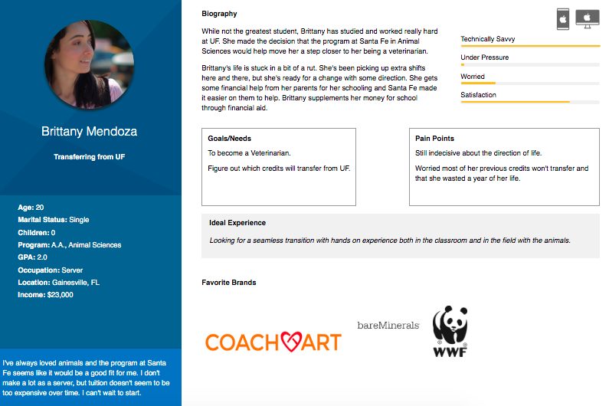

Slide 6
Brittany Mendoza User Journey
Persona
Brittany Mendoza, 20, Animal Sciences, A.A.
Scenario
Brittany is transferring from UF. She logs into the AP to figure out which credits from her transcripts will count toward her degree.
Academic Planning v1
Access
Planning
Consideration
Submit Term
Support
User Actions | Signs into eSanta Fe Clicks the Academic Planning Link. Lands on the AP Dashboard. | Navigates to previous completed term. Sees her transcript has already fulfilled term 1 of year one. | Exchanges an elective course. Clicks the course to view the details. | Brittany submits the current term and progresses through the remaining terms. | Brittany submits her current working term for advisor review. Begins chat with the advisor bot.
Touchpoints
Emotions
Pain Points | Preforming a task heavy process like academic planning on a mobile phone. |  | Wants to ensure she is taking classes that will round out her education experience. | Brittany has overloaded her course schedule for term 3.
Solutions | Reduce the amount of on screen information to only key information needed to proceed. |  | Give the users the options to setup their own plans and provide help throughout the process. | Flag this with a hard warning against taking so many classes per term. Give them an option to disregard. | The chat bot could screen through a number of questions then connect to an advisor.
eSanta Fe Login
Matrix
Cards
Course Details
Next
Finish
Submit for Review
eSanta Fe Menu
Course Add
Term
Card
Submit for Review
Matrix
AP button on Dashboard
Advisor Chat Bot
Course Add
Hard Alert
Advisor Chat Bot

Slide 7
